Slide 1
Training Session 6
Introduction to Modelling process

Slide 2
BASE VARIABLES

Slide 3
Modeling the Price variable
Hypothesis:
Price has a negative relationship with volume sales
The price sensitivity of a brand can vary by channels (TT/MT), markets etc.
Price Variable:
Smoothed price per unit or volume – Calculation of Regular/Base price from Avg. price & discounts (TPR)
Non linear transformations can also be tested – Logged price variable is usually used in this case

Slide 4
Modeling Distribution
Hypothesis:
Both Distribution (presence of a brand in a store) and the Number of Items per Store (shelf set / variety) can positively impact sales
Distribution is captured both through the width (No. of stores, Dealers) & Depth (Items per store)
Quality metrics for distribution are Out of stock (OOS), Share of visual inventory (SOVI)
Distribution Variable:
Smoothed distribution term
Non linear transformations can also be tested.

Slide 5
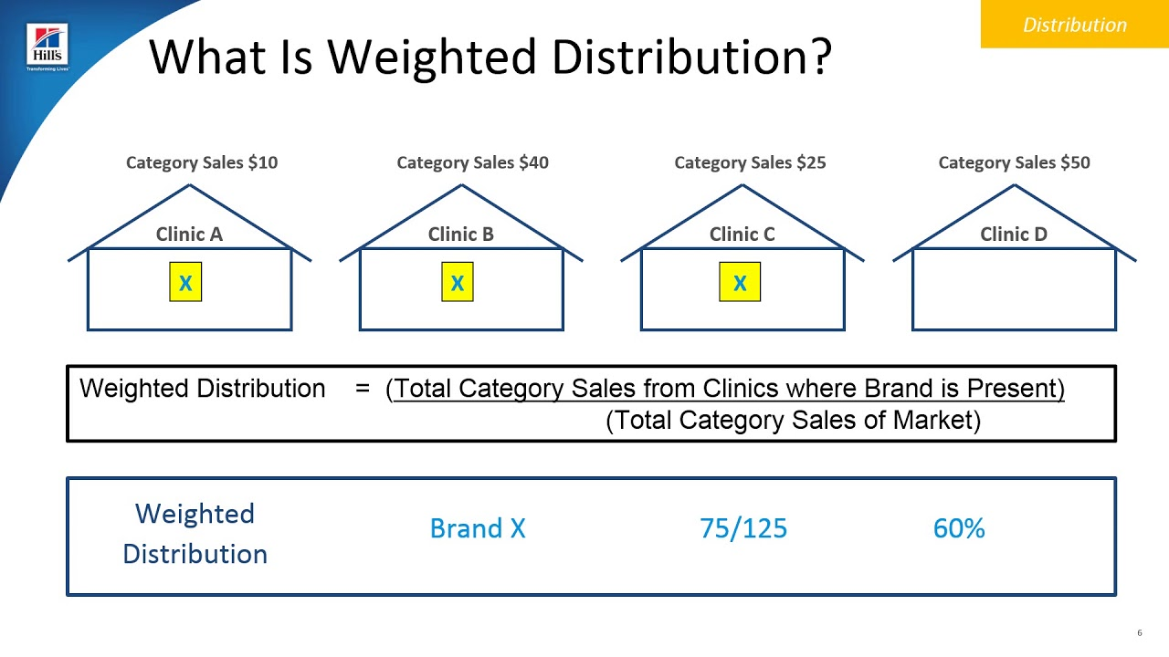
Numeric Distribution vs Weighted Distribution
Numeric Distribution
Brand x
3/4
75%

Slide 6
Other Base Variables
Macro Economic Drivers
Inflation – Used mainly to adjust the prices relative to the inflation rate
Real Private Consumption
Gross Domestic Product
Unemployment Rate
Temperature
Precipitation/Rainfall
Category Trend / Seasonality
Holidays / Festivals
Equity Variables

Slide 7
TRADE VARIABLES

Slide 8
Modeling Trade
Hypothesis:
Trade promotions have a positive impact on sales in the week of the activity
The impact of a promotion can depend on the vehicle, the %ACV coverage, and the depth of discount
Trade promotions may cause a negative impact on sales in future weeks (forward buying)
Trade Variables:
Separate variables are used for each type of promotion in order to account for differences in response
You can test the variables as is or transform using log
Promotion variables can be:
% ACV on Price Reduction – Temporary price reduction (TPR), Price discounts
% ACV on Feature – Catalogs containing information on discount
% ACV on Display
% ACV on Feature and Display

Slide 9
MEDIA VARIABLES

Slide 10
Media Transformations
Hypothesis:
There is a positive relationship between sales and advertising for a brand
Advertising airing in a week impacts sales in that week and in future weeks, and the impact diminishes over time i.e. law of diminishing returns
Threshold and saturation levels of advertising exist in the marketplace
Media Variables:
TV – HH GRPs / Spend
Digital – Impressions / Views / Clicks
Print – TRPs / Spend
Other – GRPs / Impressions / Clicks / Spend
Media variables are transformed into Ad-Stock using a retention rate (less than 100%) to account for this extended impact
Few industry ways to model media variables (in particular TV):
Ad-Stock
Exponential
Gamma

Slide 11
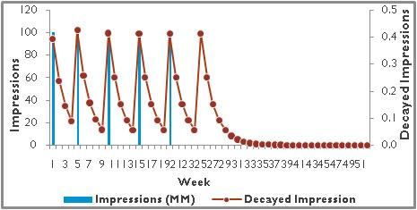
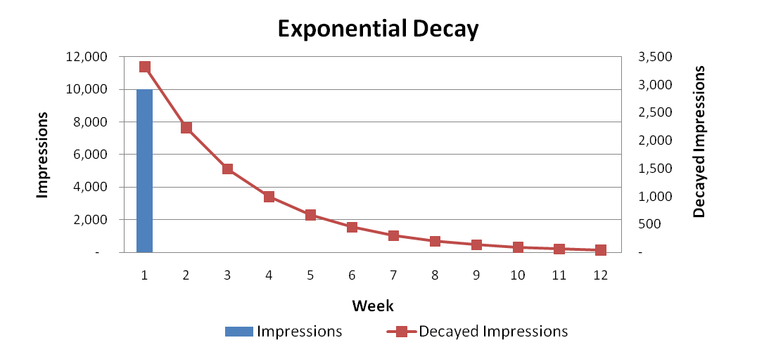
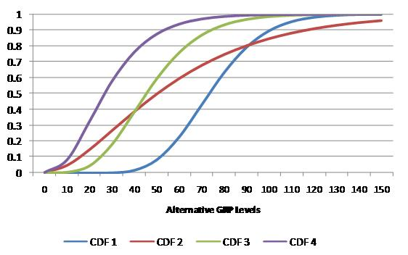
Media Transformations
Since MMM model is built using linear additive functional form, in order to capture non-linear relationship, marketing levers are transformed to align the lagged impact of the media delivery with it’s impact on consumer sales.
Ad-stock transformation:
Used with media activities likes TV, Print, Radio under the assumption that viewers who are exposed to media activity, to them advertisement awareness will decline exponentially over a period with diminishing returns i.e. Rate of change in media activity after certain level will give lesser rate of change in sales.
Parameter used – Decay rate
Exponential transformation:
Used with media activities likes TV, Print, Radio, Internet under the assumption that viewers who are exposed to media activity make purchases that decline exponentially within a specific period.
Parameters used – Decay rate & No. of weeks
Ad-bank/Gamma Transformation:
Used with media activities likes TV, Print, Radio, Online under the assumption that viewers who are exposed to media activity make purchases that decline exponentially or takes time to build and falls within a specific period. It is also known as Gamma distribution function and it incorporates diminishing return and identify minimum threshold of support.
Parameters used – Decay rate, No. of weeks & Deg. of freedom

Slide 12
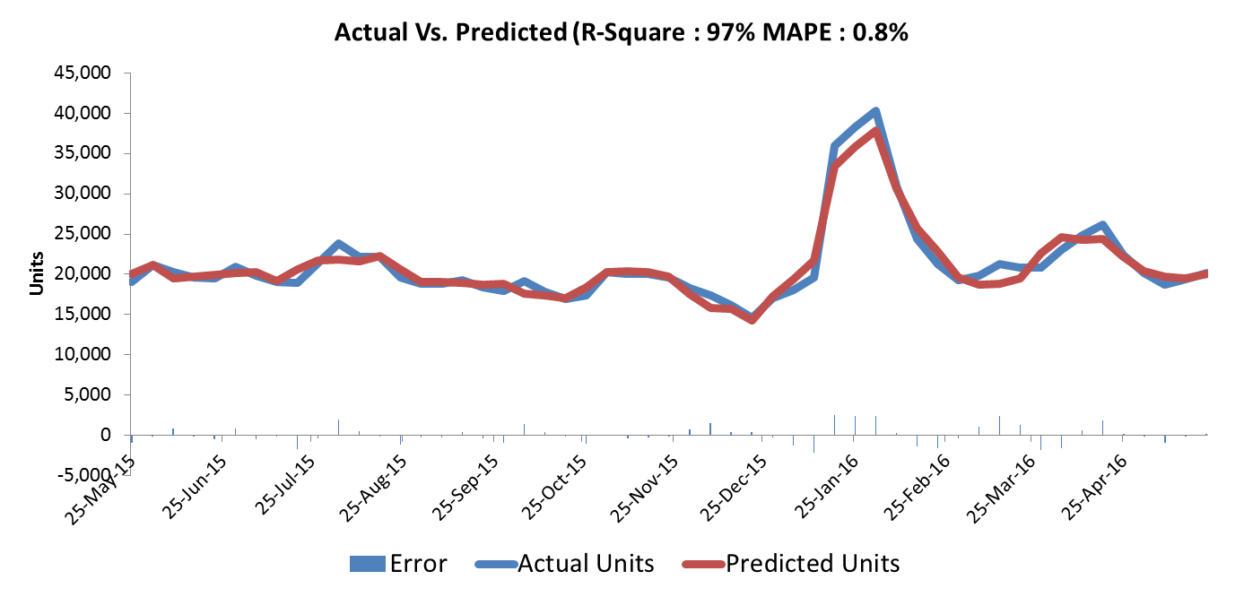
Statistical Validation
Model Fit Validation
Statistical Validity: Actual, Predicted, Error Time Series
Good alignment of the actual to the predicted volume
Residuals that appear to be random without runs of positive or negative values or particular patterns, e.g. always missing on high volume periods.
No odd jumps in the predicted volume, which can be caused by incorrect data or variable transformations
The Actual versus Predicted trend is shown in the below chart

Slide 13
Thank you

